Slide 1
Blockchain Technology

Slide 2
Brief History of Blockchain Technology
Blockchain started in 1982, when David Chaum proposed the first-ever blockchain-like protocol in his dissertation, Computer Systems Established, Maintained, and Trusted .
This concept was further worked on by Stuart Haber and W Scott Starletta in 1991, where they described the process of a cryptographically secured chain of blocks with timestamps that could not be tampered with .
However, Blockchain was first popularized by Satoshi Nakamoto in 2008 in a paper titled, “Bitcoin: A Peer-to-Peer Electronic Cash System” . The author(s) laid out the framework for blockchain and detailed methods of using a peer-to-peer network to generate a financial database.
Since then, various programmers, cryptographers, and scientists have worked on this concept of blockchain to produce a cryptocurrency network called the bitcoin. The major design goal and the purpose of the blockchain were to solve two major problems. The first is to solve the double spending problem and second was to eliminate the need of central trusted third party.

Slide 3
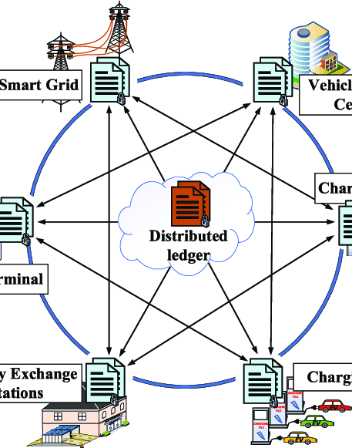
What Is a Blockchain?
A blockchain is a distributed database that is shared among the nodes of a computer network.
Blockchains are best known for their crucial role in cryptocurrency systems, such as Bitcoin, for maintaining a secure and decentralized record of transactions.
The innovation with a blockchain is that it guarantees the fidelity and security of a record of data and generates trust without the need for a trusted third party.
A blockchain collects information together in groups, known as blocks,
Blocks have certain storage capacities and, when filled, are closed and linked to the previously filled block, forming a chain of data known as the blockchain

Slide 4
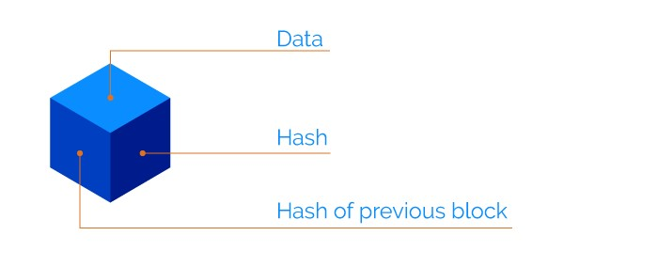
The Block Structure
A block is the building block or the key element of blockchain. A unit of data stored inside a block may be represented by any value depending on the type of blockchain.
For the Bitcoin blockchain. The blocks store number of transactions. For example, blocks are consisted of an average of more than 500 Bitcoin transactions.
A block also stores encrypted details about the parties participating in the
network, whose interaction resulted in the data stored in the block.
Each block in blockchain consists of:

Slide 5
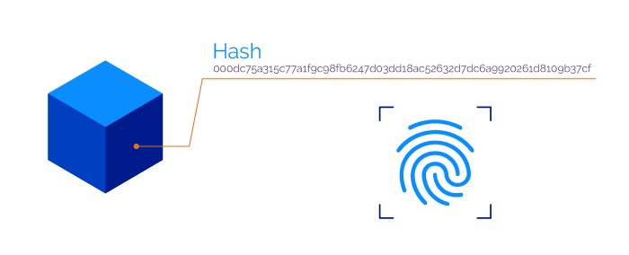
The Block Structure(con.)
▪ Data: Details of all the transactions and the contents that need to take place.
▪ Hash of the Block: The block details (including the previous hash) are transmitted through a hashing algorithm. This gives a fixed length output which is called the unique hash address. A hash can be compared to a fingerprint, as each hash is unique. Its role is to identify a block and the contents of the block
Figure (5): The hash of the block.

Slide 6
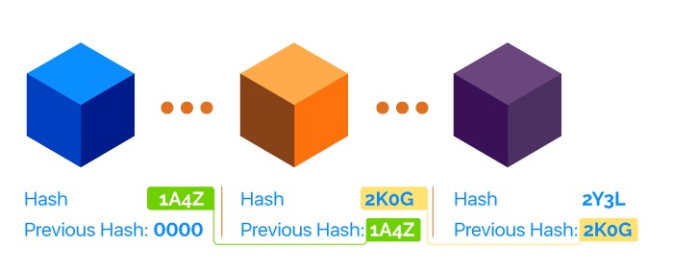
The Block Structure(con.)
Figure (5): The hash of the block.
▪ Previous Hash: The information contained in a block is dependent on and linked to the information in a previous block. Each block contains a hash of the previous block unless it is a genesis block. A genesis block is the first block in the blockchain that is hardcoded at the time the blockchain was first started
For instance, if there are three blocks in a blockchain, block 3 will contain the hash of block 2, and block 2 will contain the hash of block 1. And, over time, forms a chain of blocks. Hence the word blockchain.

Slide 7
The Block Structure(con.)
The hash is dependent on the contents of a block. The slightest change of the contents can drastically change the hash. Because of this dependency property and the fact that the blockchain is distributed, it makes it difficult to hack. This is because if someone were to change the contents of a block for their own favor, it would change the hash and the block in front of it wouldn’t match the same hash. This way, the blockchain can easily recognize changes
information
information
information
information
information
5
4
3
2
1

Slide 8
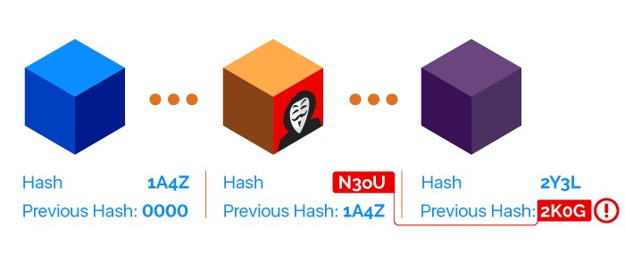
The Block Structure(con.)
The hash is dependent on the contents of a block. The slightest change of the contents can drastically change the hash. Because of this dependency property and the fact that the blockchain is distributed, it makes it difficult to hack. This is because if someone were to change the contents of a block for their own favor, it would change the hash and the block in front of it wouldn’t match the same hash. This way, the blockchain can easily recognize changes
Figure (7): Hash dependency

Slide 9
How Blockchain Works?
You should be familiar with :
Structure of the block
Cryptographic hash function
Consensus methods

Slide 10
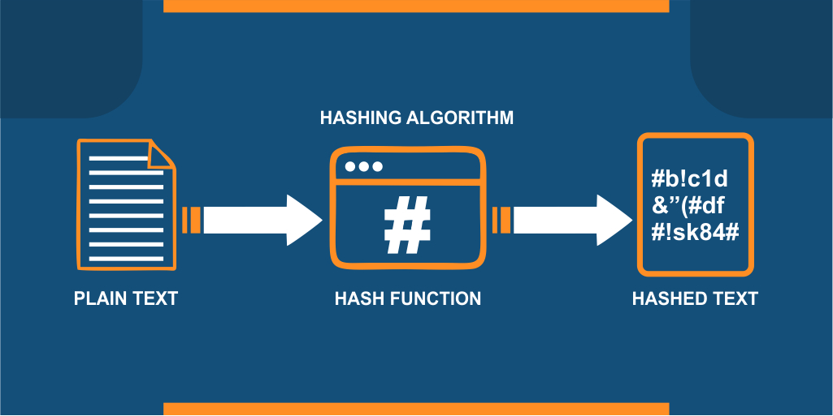
Cryptographic hashing
Hashing: means taking an input of any length and turn it into a fixed length Structure of the block

Slide 11
Cryptographic hashing
Hash function properties:
Deterministic
Quick computation
Small change in input changes the output
M = 01a60e35df88d8b49546cb3f8f4ba4f406870f9b8e1f394c9d48ab73548d748d
M1 =
1ae95de4f8f21162fc63203853d9e1d1ce92e755d564164f72cb7c4fff14ec9f
Collision resistant

Slide 12
Consensus Mechanism
A consensus Mechanism is a procedure through which all the peers of the Blockchain network reach
a common agreement about the present state of the blockchain.
Common consensus algorithms:
Proof of work (POW)
Proof of stake (POS)

Slide 13
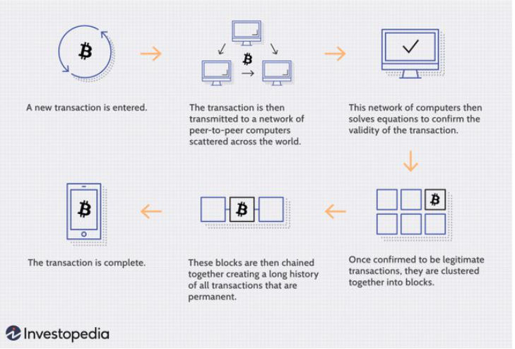
Transaction Process

Slide 14
Blockchain Basic Principles
peer-to-peer
01
The blockchain is peer to peer, which means that there is no central controller in the network
Distributed
02
The blockchain is distributed, which simply means that a ledger is spread across the network among all peers in the network
Cryptographically-secure
03
The blockchain is cryptographically-secure, by using hash algorithms to encrypt blocks which make the ledger secure against tampering and misuse.
Updateable via consensus
04
The most critical attribute of a blockchain is that it is updateable only via consensus. This is what gives it the power of decentralization

Slide 15
Advantages of Blockchain
Trust
Immutability
The blockchain is immutable and automates trusted transactions between counterparties who do not need to know each other
You can simply impress your audience and add a unique zing and appeal to your Reports.
Decentralized
No single entity maintains the network. Unlike centralized systems, decisions on the blockchain are made via consensus.
Fraud Reduction
Blockchain could minimize fraud by establishing full transaction histories within a single source of truth
Transparency
Security
One of the main benefits of a blockchain is the fact that there is a clear record of any transaction or information within a system
Due to the cryptographic nature of blockchain networks, it uses a digital signature feature to conduct fraud-free transactions which makes it more secure

Slide 16
Smart contracts, are simply programs stored on a blockchain that run when predetermined conditions are met.
They typically are used to automate the execution of an agreement so that all participants can be immediately certain of the outcome, without any involvement of third parties or time loss. They can also automate a workflow, triggering the next action when conditions are met
Smart Contracts
One of the most attractive features associated with blockchain technology is Smart contracts.

Slide 17
Benefits of Smart Contracts
A
Accuracy, Speed, and Efficiency.
There is no paperwork to deal with
B
C
The information is protected from being tampered with for personal gain because there is no third party engaged.
Eliminate the need for intermediaries to conduct transactions, as well as the time delays and fees that come with them
D

Slide 18
Types of Blockchain
There are types of blockchains, depending on the scope of its use. They are as follows:
Public Blockchain Networks
Private Blockchain Networks
Private blockchains operate on closed networks and have access restrictions, they tend to work well for private businesses and organizations [7]. Companies can use private blockchains to customize their accessibility and authorization preferences, and other important security options. Only one authority manages a private blockchain network.
As the name suggests, public blockchains are not owned by anyone. They are open to the public, and anyone can participate as a node in the decision-making process. Users may or may not be rewarded for their participation

